Slide 1
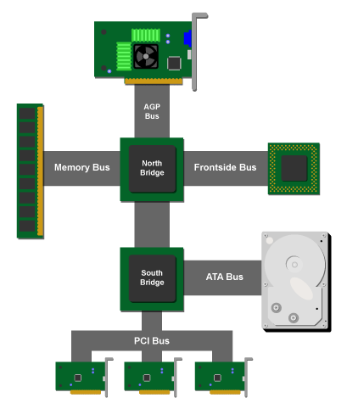
Bus and Memory Transfers

Slide 2
Register Transfer and Micro-operations 2
Connecting Registers - Bus Transfer
In a digital system with many registers,
it is impractical to have data and control lines to directly allow each register to be loaded with the contents of every possible other registers
To completely connect n registers → n(n-1) lines
So the cost is in order of O(n²) cost
This is not a realistic approach to use in a large digital system
CSE 211

Slide 3
Register Transfer and Micro-operations 3
Connecting Registers - Bus Transfer
Instead, take a different approach
Have one centralized set of circuits for data transfer – the bus
BUS STRUCTURE CONSISTS OF SET OF COMMON LINES, ONE FOR EACH BIT OF A REGISTER THROUGH WHICH BINARY INFORMATION IS TRANSFERRED ONE AT A TIME
Have control circuits to select which register is the source, and which is the destination
CSE 211

Slide 4
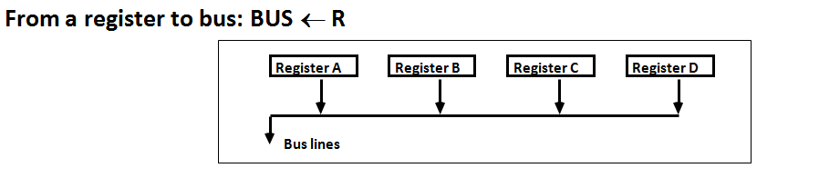
Register Transfer and Micro-operations 4
Connecting Registers - Bus Transfer
One way of constructing common bus system is with multiplexers
Multiplexer selects the source register whose binary information is kept on the bus.
Construction of bus system for 4 register (Next Fig)
4 bit register X 4
four 4X1 multiplexer
Bus selection S0, S1
CSE 211

Slide 5
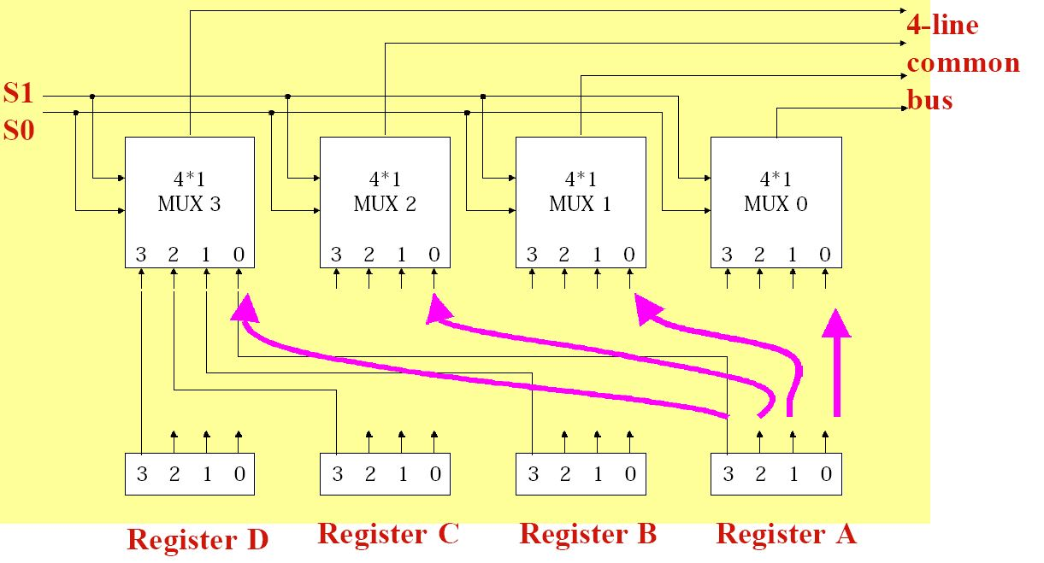
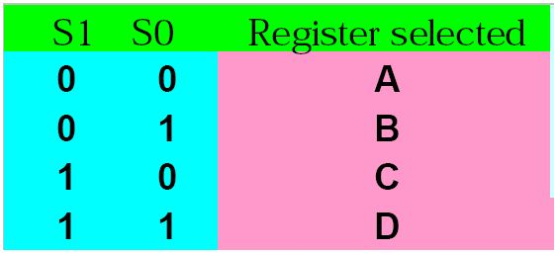
Register Transfer and Micro-operations 5
Connecting Registers - Bus Transfer
CSE 211

Slide 6
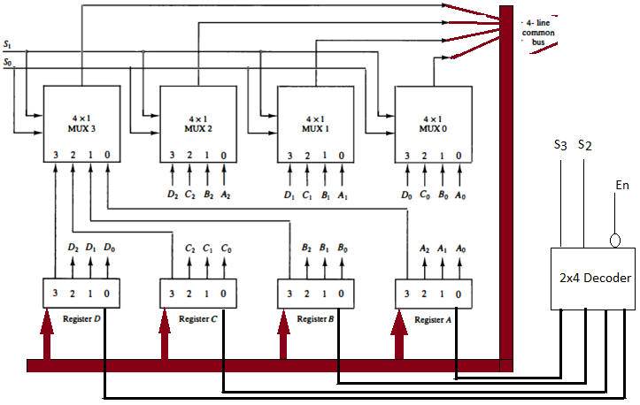

Slide 7
Register Transfer and Micro-operations 7
Connecting Registers - Bus Transfer
For a bus system to multiplex k registers of n bits each
No. of multiplexer = n = No. of bits in register (4 mux = 4 bits (0123))
Size of each multiplexer = k x 1, k data lines in each MUX
(No.of I/P in MUX = No. of register)
CSE 211

Slide 8
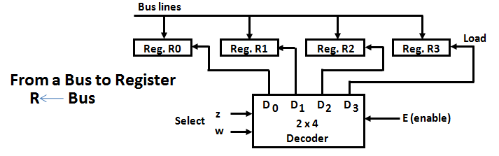
Register Transfer and Micro-operations 8
Connecting Registers - Bus Transfer
CSE 211

Slide 9
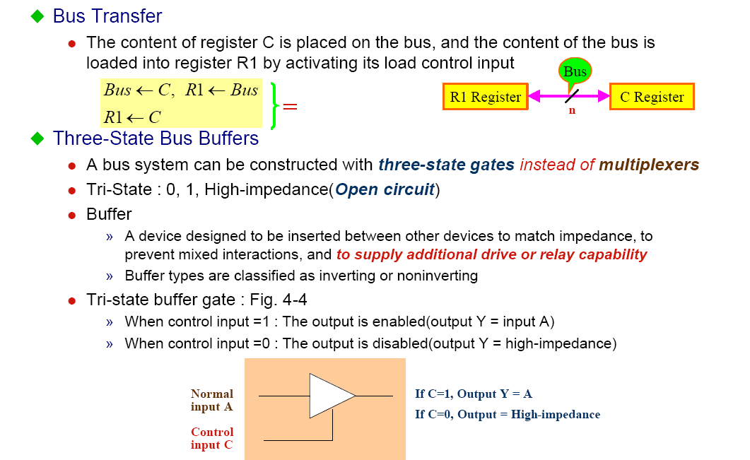
Register Transfer and Micro-operations 9
Connecting Registers - Bus Transfer
CSE 211

Slide 10
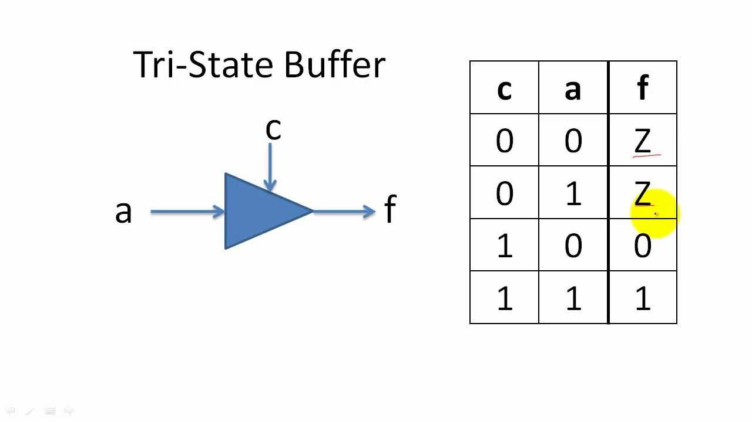
Register Transfer and Micro-operations 10
Connecting Registers - Bus Transfer
CSE 211

Slide 12
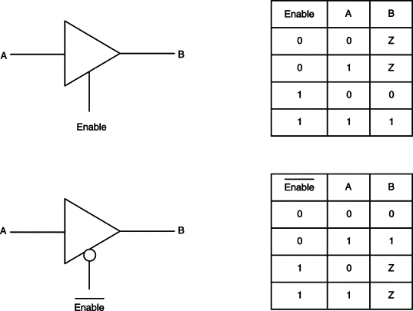

Slide 13
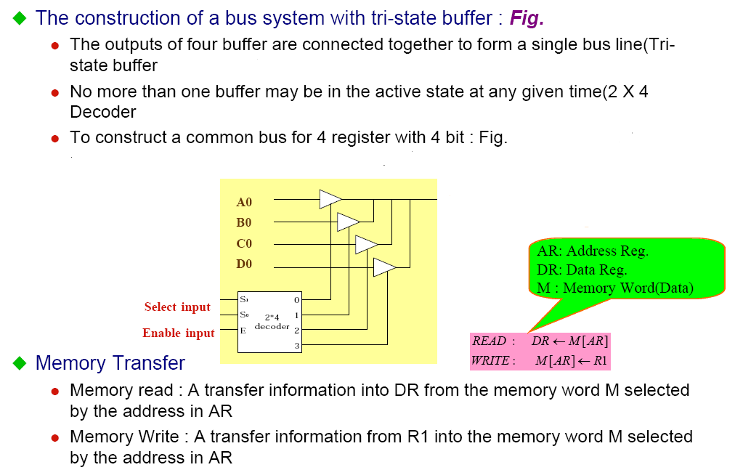
Register Transfer and Micro-operations 13
Connecting Registers - Bus Transfer
CSE 211

Slide 14
Register Transfer and Micro-operations 14
Memory - RAM
Memory (RAM) can be thought as a sequential circuits containing some number of registers
Memory stores binary information in groups of bits called words
These registers hold the words of memory
Each of the r registers is indicated by an address
These addresses range from 0 to r-1
Each register (word) can hold n bits of data

Slide 15
Register Transfer and Micro-operations 15
Memory - RAM
Assume the RAM contains r = 2^{k} words. It needs the following
n data input lines
n data output lines
k address lines
A Read control line
A Write control line
data input lines
n
address lines
k
RAM
unit
Read
Write
n
data output lines

Slide 16
Register Transfer and Micro-operations 16
Memory Transfer
Memory is usually accessed in computer systems by putting the desired address in a special register, the Memory Address Register (MAR, or AR)
M
Memory
unit
Read
AR
Write
Data out
Data in
CSE 211

Slide 17
Register Transfer and Micro-operations 17
Memory Read
To read a value from a location in memory and load it into a register, the register transfer language notation looks like this:
This causes the following to occur
The contents of the MAR get sent to the memory address lines
A Read (= 1) gets sent to the memory unit
The contents of the specified address are put on the memory’s output data lines
These get sent over the bus to be loaded into register R1
R1 ← M[MAR]
CSE 211

Slide 18
Register Transfer and Micro-operations 18
Memory Write
To write a value from a register to a location in memory looks like this in register transfer language:
This causes the following to occur
The contents of the MAR get sent to the memory address lines
A Write (= 1) gets sent to the memory unit
The values in register R1 get sent over the bus to the data input lines of the memory
The values get loaded into the specified address in the memory
M[MAR] ← R1
CSE 211

